Slide 1
IEC Models
Alex Pegoraro

Slide 2
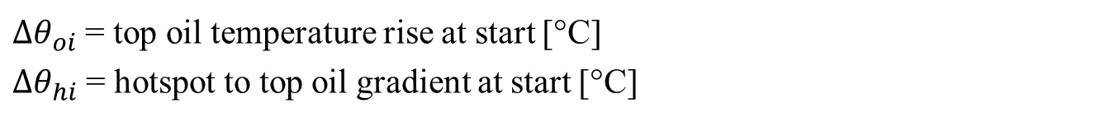
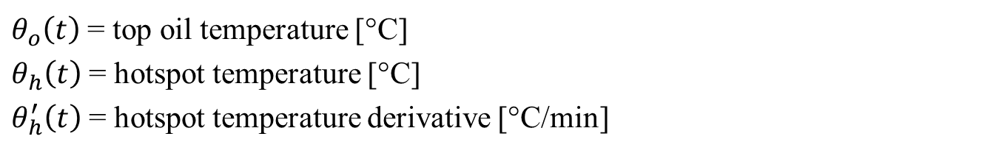
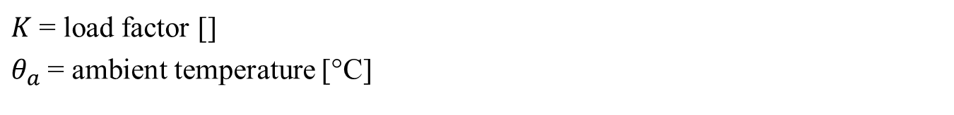
Model Variables
States:
$θ_{o}\left(t\right)$ = top oil temperature [°C]
$θ_{h}\left(t\right)$ = hotspot temperature [°C]
$θ_{h}^{′}\left(t\right)$ = hotspot temperature derivative [°C/min]
Inputs:
$K$ = load factor []
$θ_{a}$ = ambient temperature [°C]
Initial condition parameters
$Δθ_{oi}$ = top oil temperature rise at start [°C]
$Δθ_{hi}$ = hotspot to top oil gradient at start [°C]

Slide 3
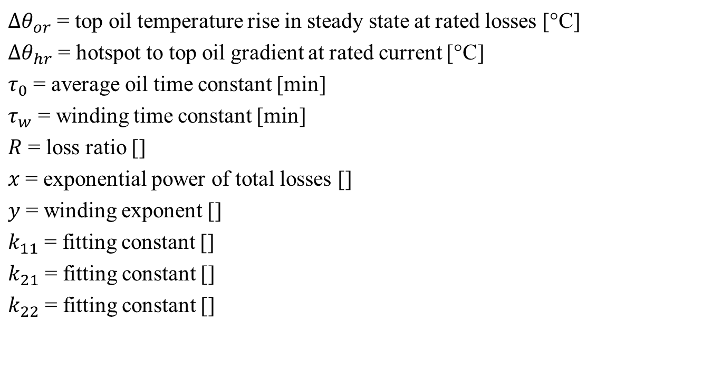
Model Variables
Transformer parameters:
$Δθ_{or}$ = top oil temperature rise in steady state at rated losses [°C]
$Δθ_{hr}$ = hotspot to top oil gradient at rated current [°C]
$τ_{0}$ = average oil time constant [min]
$τ_{w}$ = winding time constant [min]
$R$ = loss ratio []
$x$ = exponential power of total losses []
$y$ = winding exponent []
$k_{11}$ = fitting constant []
$k_{21}$ = fitting constant []
$k_{22}$ = fitting constant []

Slide 4
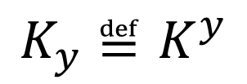
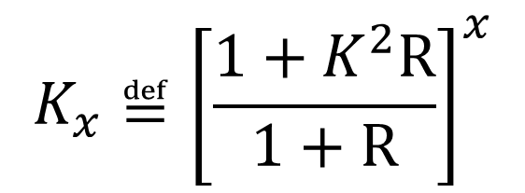
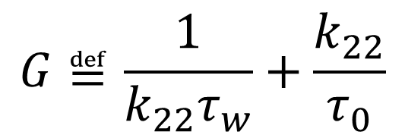
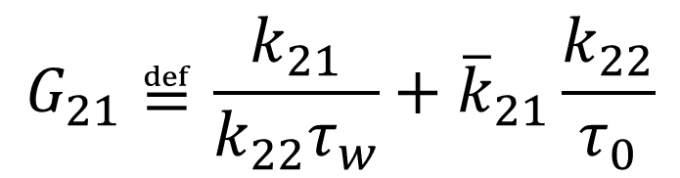

Model Variables
Handful definitions:
$$K_{x}≝{\left[\frac{1+K^{2}R}{1+R}\right]}^{x}$$
$$K_{y}≝K^{y}$$
$${\overline{k}}_{21}≝1−k_{21}$$
$$G≝\frac{1}{k_{22}τ_{w}}+\frac{k_{22}}{τ_{0}}$$
$$G_{21}≝\frac{k_{21}}{k_{22}τ_{w}}+{\overline{k}}_{21}\frac{k_{22}}{τ_{0}}$$

Slide 5



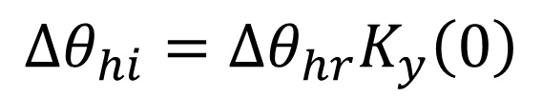

Model Variables
Initial condition assumption:
$$θ_{o}^{′}\left(0\right)=0$$
$$θ_{h}^{′}\left(0\right)=0$$
Steady state:
Consequences:
$$Δθ_{oi}=Δθ_{or}K_{x}\left(0\right)$$
$$Δθ_{hi}=Δθ_{hr}K_{y}\left(0\right)$$
$$θ_{h}^{′′}\left(0\right)=0$$

Slide 6
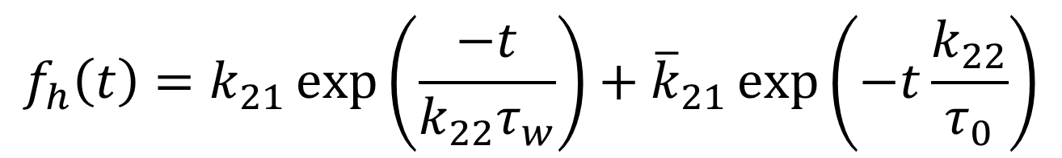
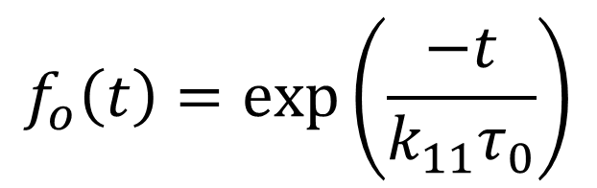
Exponential Model
Top oil:
$$θ_{o}\left(t\right)=θ_{a}\left(t\right)+Δθ_{or}K_{x}+\left[Δθ_{oi}−Δθ_{or}K_{x}\right]f_{o}\left(t\right)$$
$$f_{o}\left(t\right)=\exp\left(\frac{−t}{k_{11}τ_{0}}\right)$$
Hotspot:
$$θ_{h}\left(t\right)=θ_{o}\left(t\right)+Δθ_{hr}K_{y}+\left[Δθ_{hi}−Δθ_{hr}K_{y}\right]f_{h}\left(t\right)$$
$$f_{h}\left(t\right)=k_{21}\exp\left(\frac{−t}{k_{22}τ_{w}}\right)+{\overline{k}}_{21}\exp\left(−t\frac{k_{22}}{τ_{0}}\right)$$

Slide 7



I Order Model
Top oil:
$$k_{11}τ_{o}θ_{o}^{′}+θ_{o}=θ_{a}+Δθ_{or}K_{x}$$
$$θ_{o}\left(0\right)=θ_{a}\left(0\right)+Δθ_{oi}$$
Hotspot:
$$θ_{h}=θ_{o}+θ_{h1}+θ_{h2}$$

Slide 8
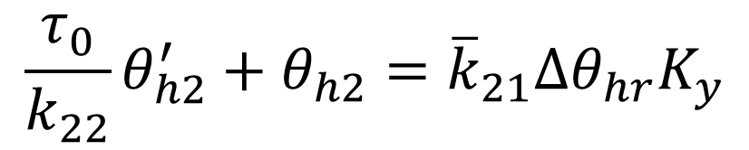
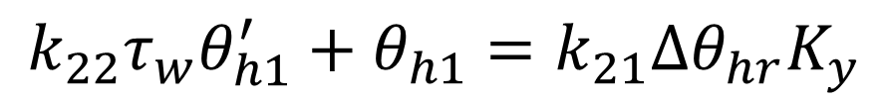


I Order Model
Hotspot components:
$$k_{22}τ_{w}θ_{h1}^{′}+θ_{h1}=k_{21}Δθ_{hr}K_{y}$$
$$θ_{h1}\left(0\right)=k_{21}Δθ_{hi}$$
$$\frac{τ_{0}}{k_{22}}θ_{h2}^{′}+θ_{h2}={\overline{k}}_{21}Δθ_{hr}K_{y}$$
$$θ_{h2}\left(0\right)={\overline{k}}_{21}Δθ_{hi}$$

Slide 9
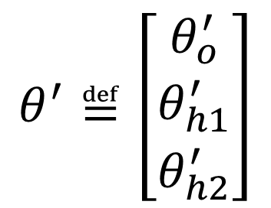

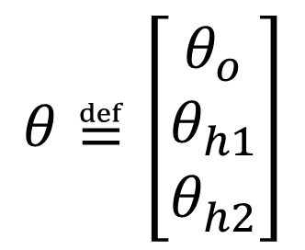
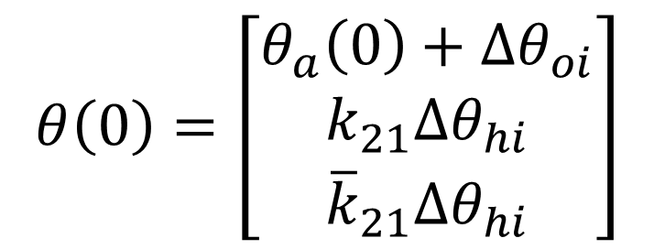
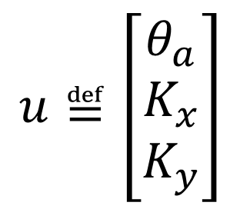
I Order Model
Lyapunov form:
$$θ^{′}=Aθ+Bu$$
$$θ^{′}≝\left[\begin{matrix}θ_{o}^{′} \\ θ_{h1}^{′} \\ θ_{h2}^{′}\end{matrix}\right]$$
$$θ≝\left[\begin{matrix}θ_{o} \\ θ_{h1} \\ θ_{h2}^{}\end{matrix}\right]$$
$$u≝\left[\begin{matrix}θ_{a} \\ K_{x} \\ K_{y}\end{matrix}\right]$$
$$θ\left(0\right)=\left[\begin{matrix}θ_{a}\left(0\right)+Δθ_{oi} \\ k_{21}Δθ_{hi} \\ {\overline{k}}_{21}Δθ_{hi}\end{matrix}\right]$$

Slide 10
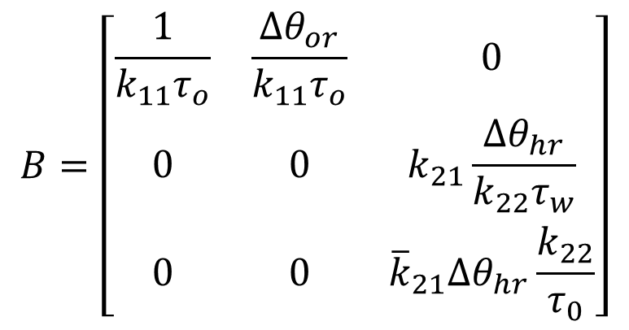
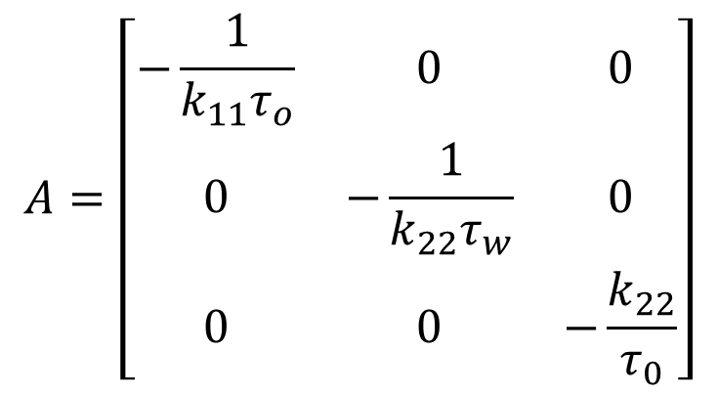
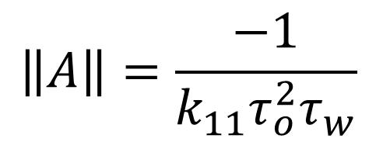
I Order Model
Lyapunov form:
$$θ^{′}=Aθ+Bu$$
$$A=\left[\begin{matrix}−\frac{1}{k_{11}τ_{o}} & 0 & 0 \\ 0 & −\frac{1}{k_{22}τ_{w}} & 0 \\ 0 & 0 & −\frac{k_{22}}{τ_{0}}\end{matrix}\right]$$
$$B=\left[\begin{matrix}\frac{1}{k_{11}τ_{o}} & \frac{Δθ_{or}}{k_{11}τ_{o}} & 0 \\ 0 & 0 & k_{21}\frac{Δθ_{hr}}{k_{22}τ_{w}} \\ 0 & 0 & {\overline{k}}_{21}Δθ_{hr}\frac{k_{22}}{τ_{0}}\end{matrix}\right]$$
$$\left\|A\right\|=\frac{−1}{k_{11}τ_{o}^{2}τ_{w}}$$

Slide 11


II Order Model
Top oil:
$$θ_{o}=θ_{a}+Δθ_{or}K_{x}−k_{11}τ_{o}θ_{o}^{′}$$
$$θ_{o}\left(0\right)=θ_{a}\left(0\right)+Δθ_{oi}$$
Hotspot:
$$θ_{h}=θ_{o}+θ_{ho}$$

Slide 12


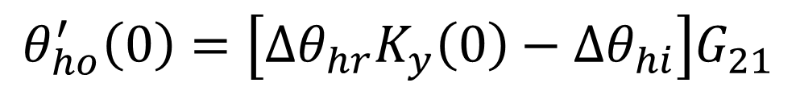
II Order Model
Hotspot components:
$$θ_{ho}=Δθ_{hr}K_{y}−Gτ_{0}τ_{w}θ_{ho}^{′}−τ_{0}τ_{w}θ_{ho}^{′′}$$
$$θ_{ho}\left(0\right)=Δθ_{hi}$$
$$θ_{ho}^{′}\left(0\right)=\left[Δθ_{hr}K_{y}\left(0\right)−Δθ_{hi}\right]G_{21}$$
$$θ_{ho}^{′}\left(0\right)=0$$
If we assume steady state:

Slide 13
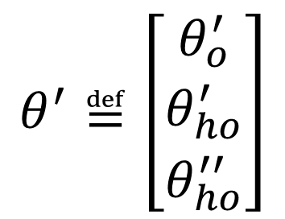
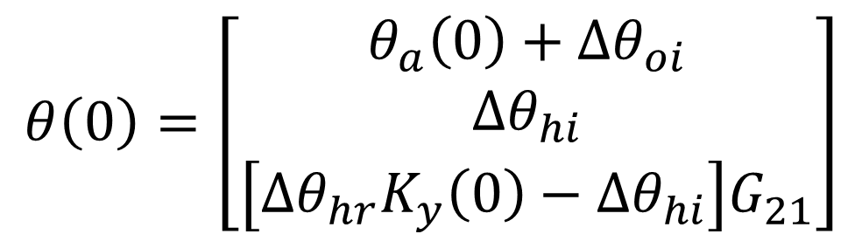
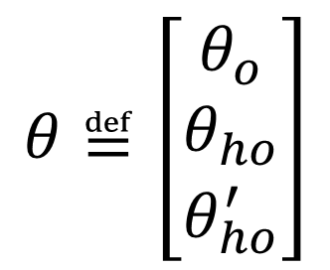
II Order Model
Lyapunov form:
$$θ^{′}=Aθ+Bu$$
$$θ^{′}≝\left[\begin{matrix}θ_{o}^{′} \\ θ_{ho}^{′} \\ θ_{ho}^{′′}\end{matrix}\right]$$
$$θ≝\left[\begin{matrix}θ_{o} \\ θ_{ho} \\ θ_{ho}^{′}\end{matrix}\right]$$
$$u≝\left[\begin{matrix}θ_{a} \\ K_{x} \\ K_{y}\end{matrix}\right]$$
$$θ\left(0\right)=\left[\begin{matrix}θ_{a}\left(0\right)+Δθ_{oi} \\ Δθ_{hi} \\ \left[Δθ_{hr}K_{y}\left(0\right)−Δθ_{hi}\right]G_{21}\end{matrix}\right]$$

Slide 14
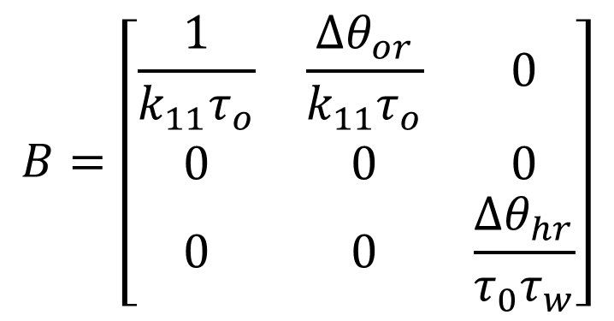
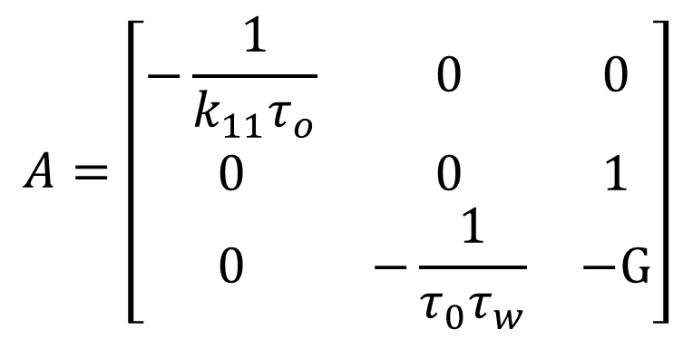
II Order Model
Lyapunov form:
$$θ^{′}=Aθ+Bu$$
$$A=\left[\begin{matrix}−\frac{1}{k_{11}τ_{o}} & 0 & 0 \\ 0 & 0 & 1 \\ 0 & −\frac{1}{τ_{0}τ_{w}} & −G\end{matrix}\right]$$
$$B=\left[\begin{matrix}\frac{1}{k_{11}τ_{o}} & \frac{Δθ_{or}}{k_{11}τ_{o}} & 0 \\ 0 & 0 & 0 \\ 0 & 0 & \frac{Δθ_{hr}}{τ_{0}τ_{w}}\end{matrix}\right]$$
$$\left\|A\right\|=\frac{−1}{k_{11}τ_{o}^{2}τ_{w}}$$

Slide 15
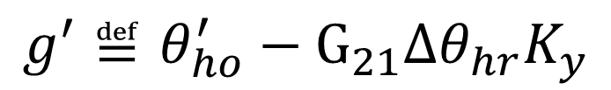
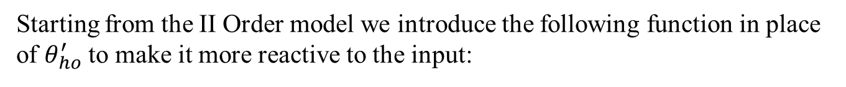
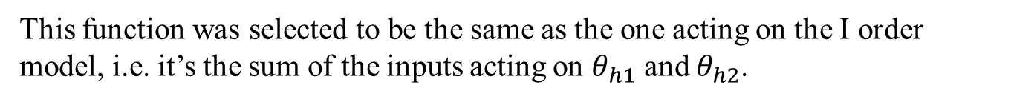
Reactive II Order Model
Assumptions:
Starting from the II Order model we introduce the following function in place of $θ_{ho}^{′}$ to make it more reactive to the input:
$$g^{′}≝θ_{ho}^{′}−G_{21}Δθ_{hr}K_{y}$$
This function was selected to be the same as the one acting on the I order model, i.e. it’s the sum of the inputs acting on $θ_{h1}$ and $θ_{h2}$.

Slide 16
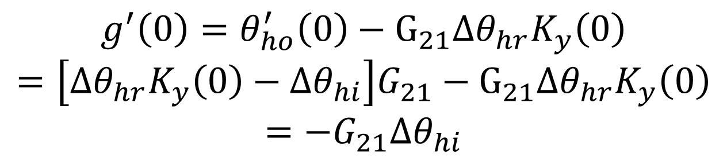
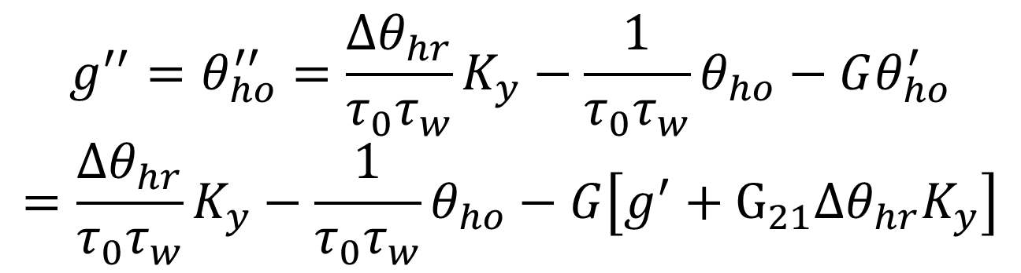
Reactive II Order Model
Consequences:
$$g^{′}\left(0\right)=θ_{ho}^{′}\left(0\right)−G_{21}Δθ_{hr}K_{y}\left(0\right)$$
$$=\left[Δθ_{hr}K_{y}\left(0\right)−Δθ_{hi}\right]G_{21}−G_{21}Δθ_{hr}K_{y}\left(0\right)$$
$$=−G_{21}Δθ_{hi}$$
$$g^{′′}=θ_{ho}^{′′}=\frac{Δθ_{hr}}{τ_{0}τ_{w}}K_{y}−\frac{1}{τ_{0}τ_{w}}θ_{ho}−Gθ_{ho}^{′}$$
$$=\frac{Δθ_{hr}}{τ_{0}τ_{w}}K_{y}−\frac{1}{τ_{0}τ_{w}}θ_{ho}−G\left[g^{′}+G_{21}Δθ_{hr}K_{y}\right]$$

Slide 17
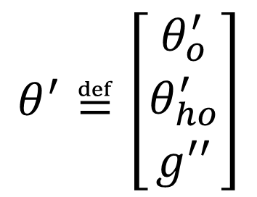
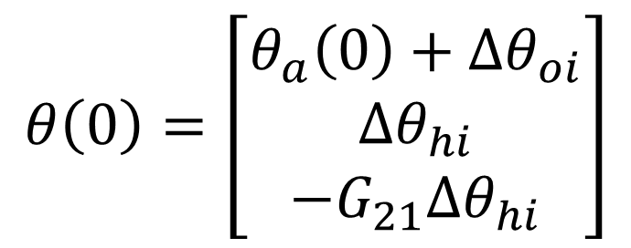
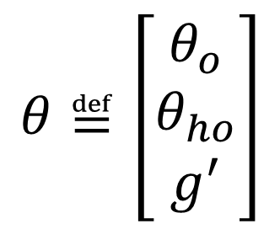
Reactive II Order Model
Lyapunov form:
$$θ^{′}=Aθ+Bu$$
$$θ^{′}≝\left[\begin{matrix}θ_{o}^{′} \\ θ_{ho}^{′} \\ g^{′′}\end{matrix}\right]$$
$$θ≝\left[\begin{matrix}θ_{o} \\ θ_{ho} \\ g^{′}\end{matrix}\right]$$
$$u≝\left[\begin{matrix}θ_{a} \\ K_{x} \\ K_{y}\end{matrix}\right]$$
$$θ\left(0\right)=\left[\begin{matrix}θ_{a}\left(0\right)+Δθ_{oi} \\ Δθ_{hi} \\ −G_{21}Δθ_{hi}\end{matrix}\right]$$

Slide 18
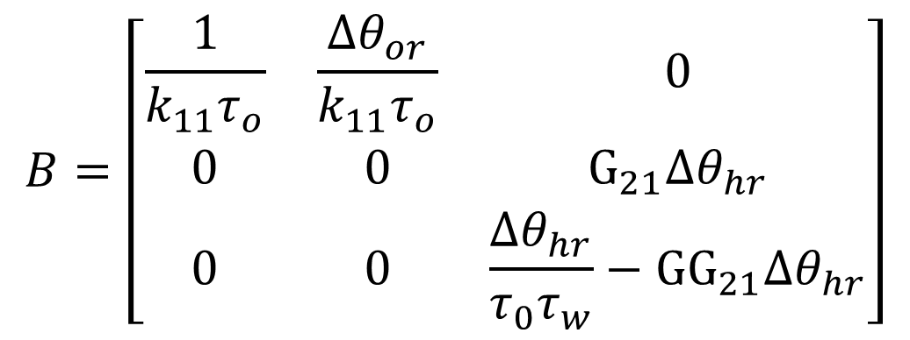
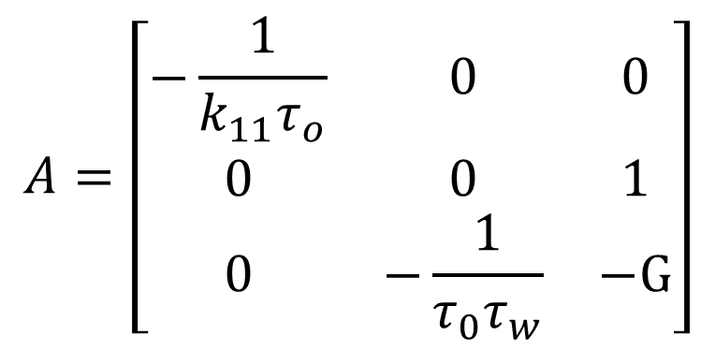
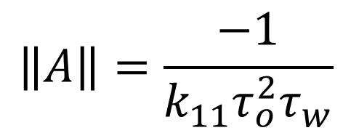
Reactive II Order Model
Lyapunov form:
$$θ^{′}=Aθ+Bu$$
$$A=\left[\begin{matrix}−\frac{1}{k_{11}τ_{o}} & 0 & 0 \\ 0 & 0 & 1 \\ 0 & −\frac{1}{τ_{0}τ_{w}} & −G\end{matrix}\right]$$
$$\left\|A\right\|=\frac{−1}{k_{11}τ_{o}^{2}τ_{w}}$$
$$B=\left[\begin{matrix}\frac{1}{k_{11}τ_{o}} & \frac{Δθ_{or}}{k_{11}τ_{o}} & 0 \\ 0 & 0 & G_{21}Δθ_{hr} \\ 0 & 0 & \frac{Δθ_{hr}}{τ_{0}τ_{w}}−GG_{21}Δθ_{hr}\end{matrix}\right]$$

Slide 19
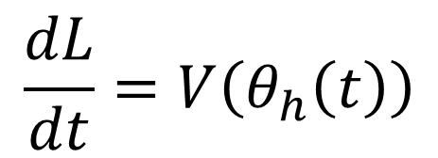
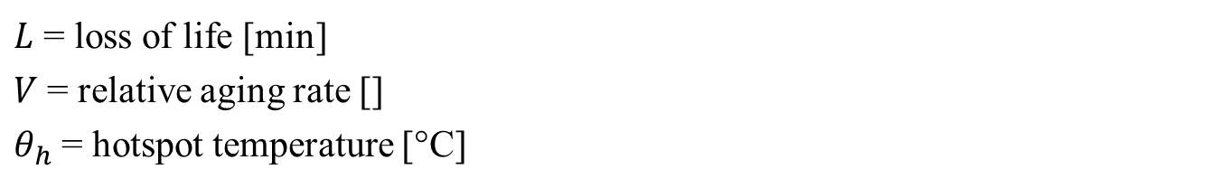

Loss of Life
Variables:
$L$ = loss of life [min]
$V$ = relative aging rate []
$θ_{h}$ = hotspot temperature [°C]
Formula:
$$\frac{dL}{dt}=V\left(θ_{h}\left(t\right)\right)$$
$$L\left(0\right)=0$$

Slide 20
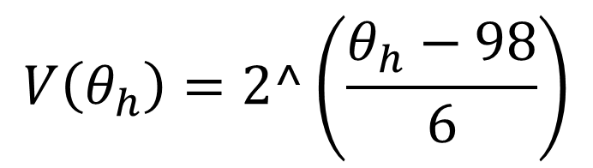
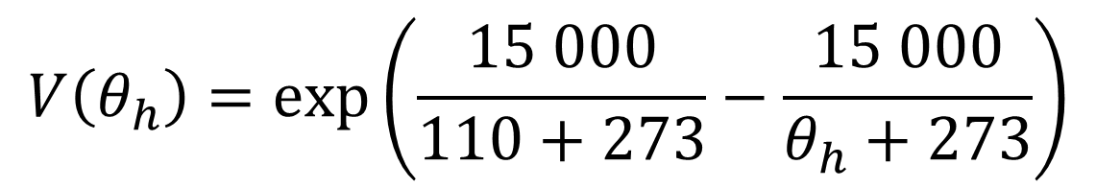
Loss of Life
Thermally upgraded paper:
$$V\left(θ_{h}\right)=\exp\left(\frac{15 000}{110+273}−\frac{15 000}{θ_{h}+273}\right)$$
NON thermally upgraded paper:
$$V\left(θ_{h}\right)=2^\left(\frac{θ_{h}−98}{6}\right)$$

